Slide 1
Marketing KPI

Slide 2
Marketing KPIs to enhance Lead Generation & enable distribution
Key Metrices
Ideal Customer Journey
Unique web site visitors
Interest on events
New email subscriptions (rate per visits)
Brand reputation
Number of pages visited
Bounce rate (landing and leaving)
Sees Promotional Material
BRAND AWARENESS
Attend event/visits website
Time on site, and frequency of visits
Click through rate on newsletters
Attendance to events - rate and totals
Attendance to meetings - rate and totals
New customers (cookies) looking at webcast
% of webcasts that are watched to completion
Subscribes to newsletter
INTEREST/
ENGAGEMENT
Reads website articles
Number of introductory meetings
Newly created opportunities*
Later stage opportunities*
Total unique customers attending meetings
Transitions to the next score of conversion chances
# (or %) of meetings with +ve tone
CONSIDERATION
Request meeting
Discusses needs
Avg months from 1st contact to conversion
Avg num of meetings per conversion
Avg. AUM per monthly conversion
CONVERSION
Conversion
Click through rate on newsletters
Cross sell of products and offerings
Mandates per customer
Average AUM per mandate
Clients at risk (# and AUM)
DEEPENING
Cross Sell/Increase AUM

Slide 3
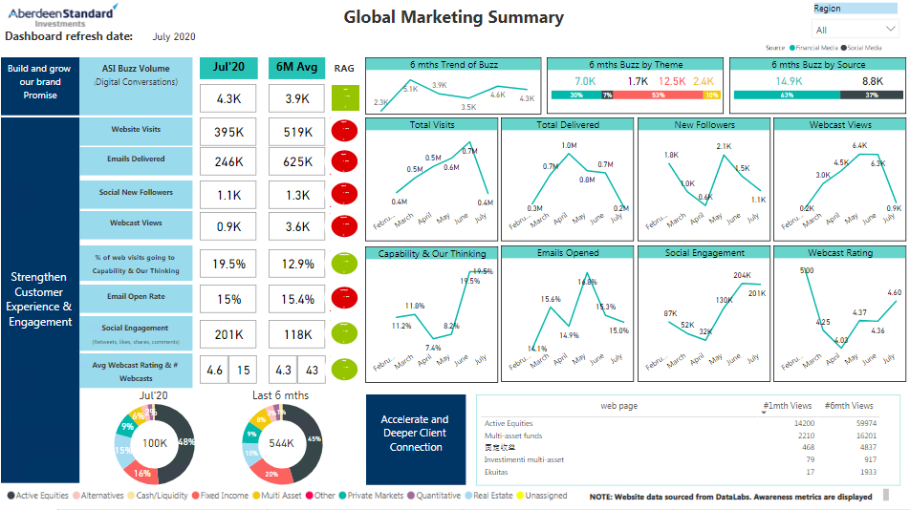
Marketing KPI – Monthly Marketing Report

Slide 4
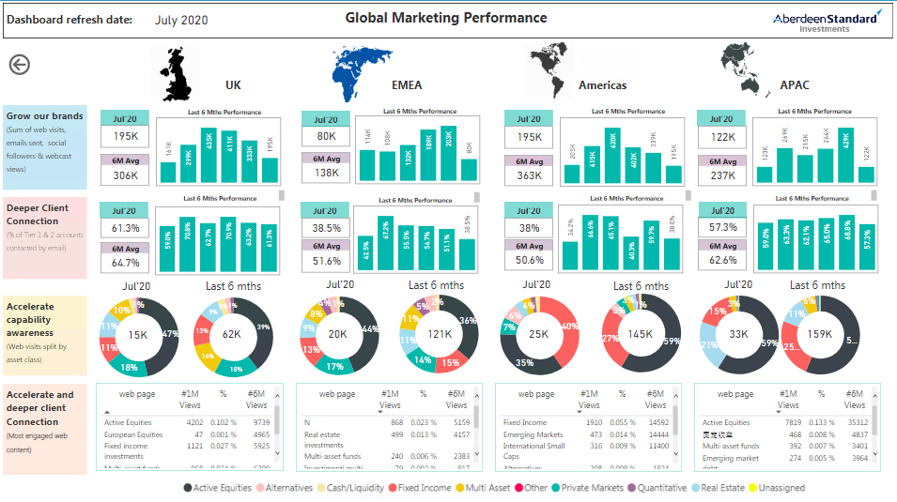
Marketing KPI – Monthly Marketing Performance

Slide 5
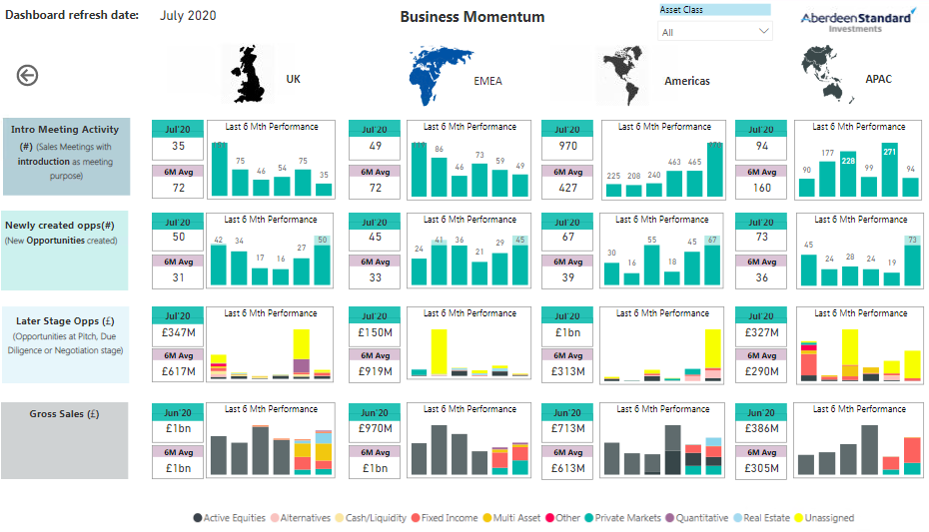
Marketing KPI – Monthly Business Momentum

Slide 6
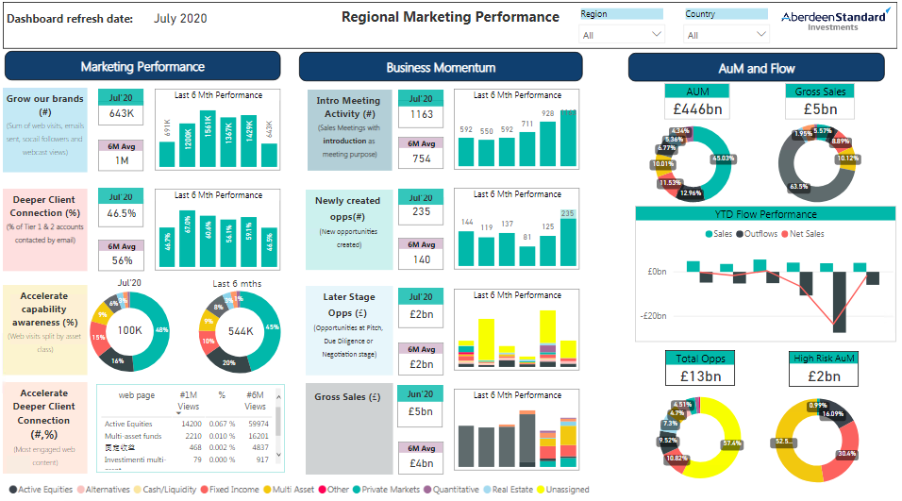
Marketing KPI – Regional Marketing Performance

Slide 7
UK Wholesale Targeting

Slide 8
Personalized Targeting using Look-Alike Modeling
Business Context
Client is global investment company and the largest active asset manager in the UK, with investments in equities, multi-asset, fixed income, real estate and private markets.
Assets
Funds
Manages assets about ~$670 BN
Accounts
Operates 30+ funds
7k+ unique account
Investment Capabilities
Manages assets Over 10+ asset classes
Objective
To increase the response rate of monthly promotional email campaigns
…This recommendation will help overall improvement in the customer email engagement
←

Slide 9
Personalized Targeting using Look-Alike Modeling
DIAGNOSTICS
SOLUTION
IMPACT
Existing State:
Lack of a scientific data-driven approach to targeting customers for new campaigns: The marketing team targeted customers based on pre-set rules which did not consider past behavior and targeted all customers using a broad marketing strategy, resulting in low marketing effectiveness.
Problem Statement:
Identify accounts promoted using direct marketing using past customer interactions data.
Segmented accounts based historical transactions for a more personalized segment marketing.
Provide clear target segments for relevant messaging to generate better message coherence.
To Identify the best set of prospects with high chances to invest in a fund using a look a like model.
Measure campaign effectiveness and understanding the impact of direct marketing activities by attributing sales from the campaign
Data Sources Considered:
Transactions Data : Financial – Total In, Gross Sales, Gross Redemptions and AUM
Interactions Data : Campaigns – Emails, Events and Campaigns
Third Party Data : Client share of Market data.
←

Slide 10






Personalized Targeting using Look-Alike Modeling
DIAGNOSTICS
SOLUTION
IMPACT
Fund Specific Target Identification Process
Event attendees are considered based on the following factors:
All attendees of an event with the fund mentioned in meeting description.
All conference call attendees.
Attendees of events with positive tone.
Event Attendees
Past Engagements
Fund level Email Click-Through / Open in the last 1 year.
Final
List of
target
accounts
for
Campaign
Pearson Similarity Index Model based on
Allocation behaviour across sectors
Investments in client's company & market share
Look-Alike Model between
Client and Prospects
Market Share
Client’s Financials
RFM – Recency, Frequency, Monetary model – identify high wallet frequent investors
Customer Segmentation technique based on Frequent, recent and high investors
Recency
Frequency
Monetary
Consistent Investment in an IA sector.
Response for earlier campaigns.
Investors with AUM > £1M.
Business Ruleset
←

Slide 11
Personalized Targeting using Look-Alike Modeling
DIAGNOSTICS
SOLUTION
IMPACT
Customer segmentation and Message coherence
Identified Targets
Prospects invested in this sector through other players
Prospects Investing in this Sector for the first time
Clients Investing in this Sector for the first time
Clients investing in this fund for first time but invested in the sector before
Clients invested in this sector through other players
Segment the identified prospects based on characteristics and behaviour
Send Personalised marketing content for each segment to engage customers more effectively

Slide 12
UK Wholesale Reporting

Slide 13


Standardization and Consolidation of UKW Marketing Metrics
DIAGNOSTICS
SOLUTION
Existing State:
Lack of a systematic way to understand the marketing impact on campaigns: The marketing team spend in their campaigns and other marketing events but there is no space to measure the impact of their investment on a campaign. Also there is no method to drive lead generation based on campaigns.
Problem Statement:
Identify accounts promoted using direct marketing using past customer interactions data.
Segmented accounts based historical transactions for a more personalized segment marketing.
Provide clear target segments for relevant messaging to generate better message coherence.
Measure campaign effectiveness and understanding the impact of direct marketing activities by attributing sales from the campaign.
Data Sources Considered:
Interactions Data
Transactions Data
External Data
(Market Share)
←
(Meetings, Campaigns)
(Emails)
(Clients Total In, AUM, etc.,)
(Market Share details of accounts at IA Sector level)

Slide 14

Standardization and Consolidation of UKW Marketing Metrics
DIAGNOSTICS
SOLUTION
Campaign Effectiveness Measurement
Lead Profiling
Data Extraction
Intermediate Tables
Final Table Creation
Ruleset :
New clients of ASI
Clients who increased their market share within ASI
Clients who increased in a particular IA sector and fund for the first time
New clients of ASI
Clients who increased their market share within ASI
Clients who increased in a particular IA sector and fund for the first time
Flags built to answer specific business questions
Hot
Leads
Q1: Is the Account Present in Salesforce
Q2: Has the Account been a part of any promotional Campaign
Clients who have neutral market share within ASI
Clients who invested in a particular IA sector before but in this fund for the first time
Q3: Has the Account Invested in specific fund
Clients who have neutral market share within ASI
Clients who invested in a particular IA sector before but in this fund for the first time
Warm
Leads
Q4: Is the Account an Existing Investor in the fund
Q5: Is the Account an Existing Client of ASI
Q6: Has the Account Invested in the same IA sector as the Fund
Clients who have decreased market share within ASI
Retention
Leads
Q7: Has the Market share of the Account varied in the specific IA sector (Increase, Decrease or No Change)
Q8: Has the Account attended any meetings in past 6 months

